Slide 1

j.health
Made by:
Antonio Butigan
Josip Mužić

Slide 2
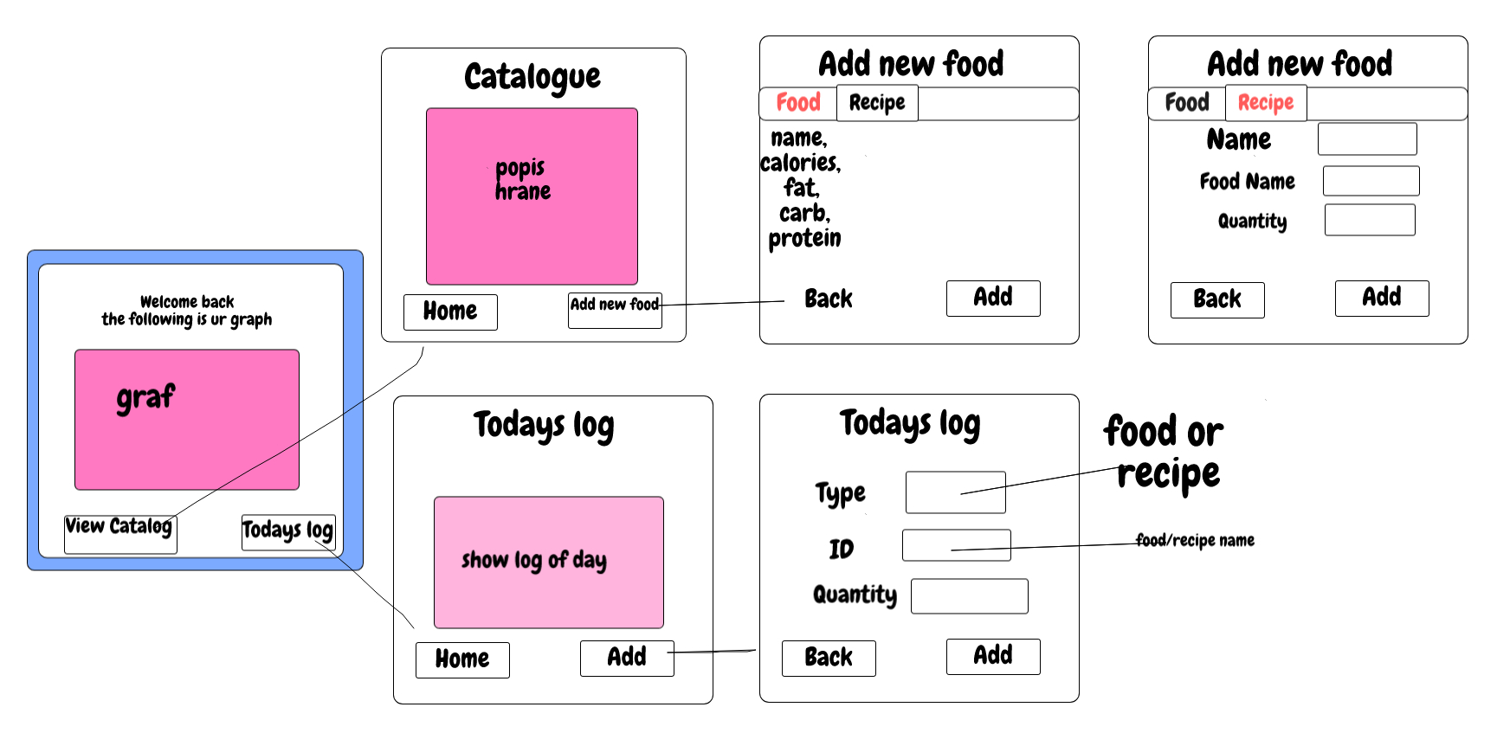

The design (Sketchpad)

Slide 3
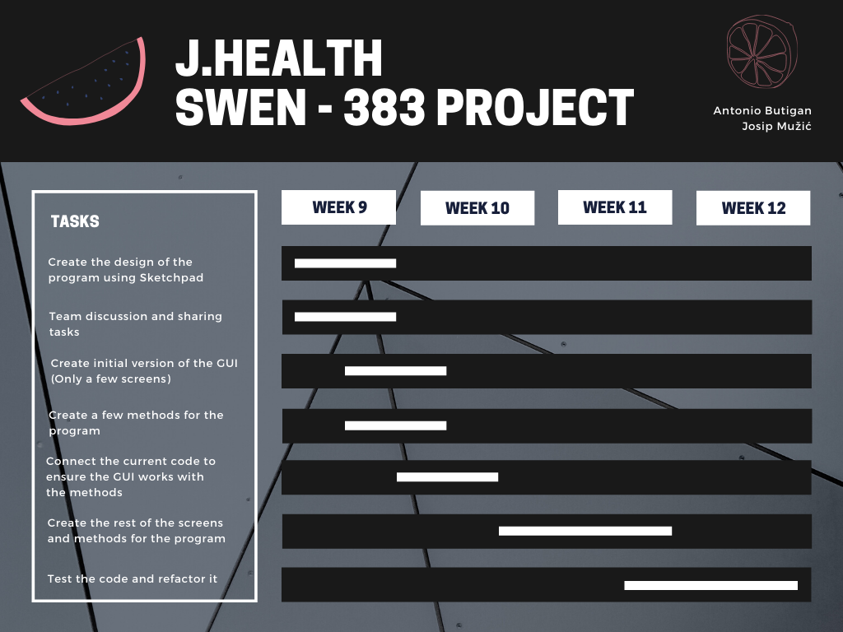
Task handling

Slide 4
Classes
Item, Food, Recipe, ItemAdapter, ItemFactory, DailyLog, FileManager.
ProjectUI, ProjectMethods

Slide 5
Patterns we used
4 patterns
Composite pattern – Food.java
Adapter pattern – ItemAdapter.java
Factory pattern – ItemFactory.java
Proxy pattern – FileManager.java

Slide 6
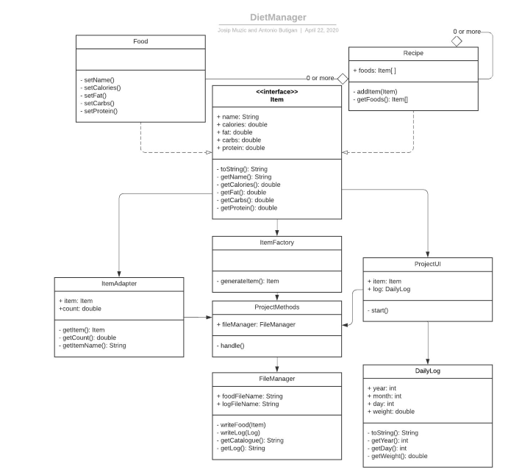
UML DIAGRAM

Slide 7
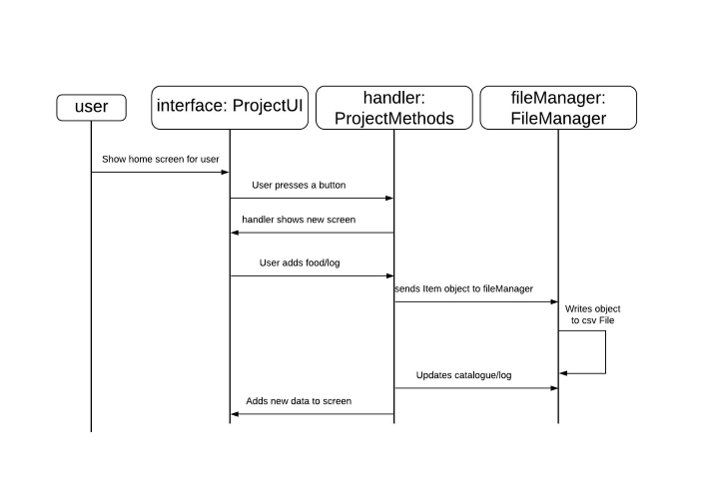
SEQUENCE DIAGRAM

Slide 8
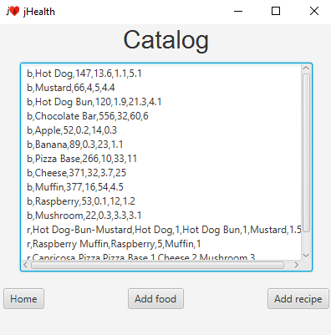
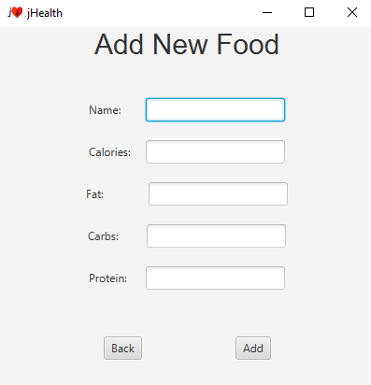
Snippets

Slide 9
THe good

Slide 10
The bad

Slide 11
Thank you!
JHealth
The cRITers Team
And now for the code...

